Slide 1

Customer Shopping Behavior Analysis
Uncovering insights from 3,900 transactions across product categories to guide strategic business decisions.

Slide 2
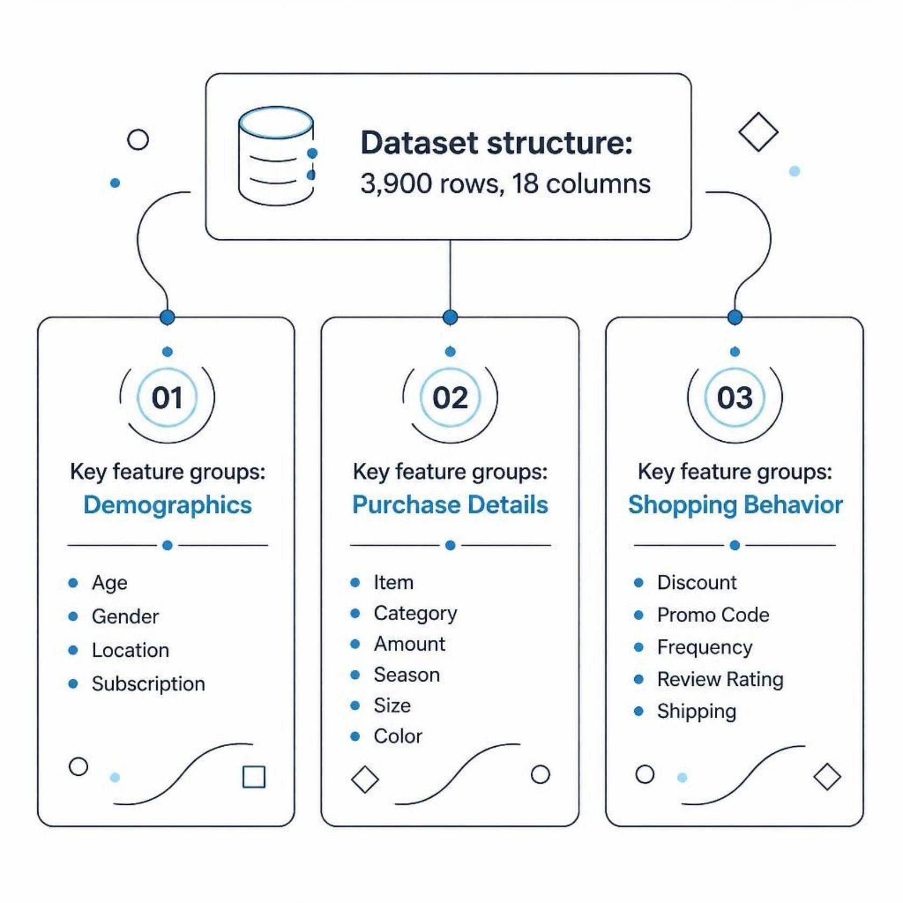
Dataset at a Glance
3,900 Purchases
18 columns spanning demographics, purchase details, and shopping behavior.
2 Genders · 4 Categories · 50 Locations
Avg. purchase: $59.76
Avg. age: 44 years
37 missing values in Review Rating

Slide 3

Data Preparation in Python
Clean & Standardize
Feature Engineering
Imputed missing Review Ratings; renamed columns to snake_case
Created age_group and purchase_frequency_days columns
Database Load
Connected to PostgreSQL; loaded cleaned DataFrame for SQL analysis

Slide 4
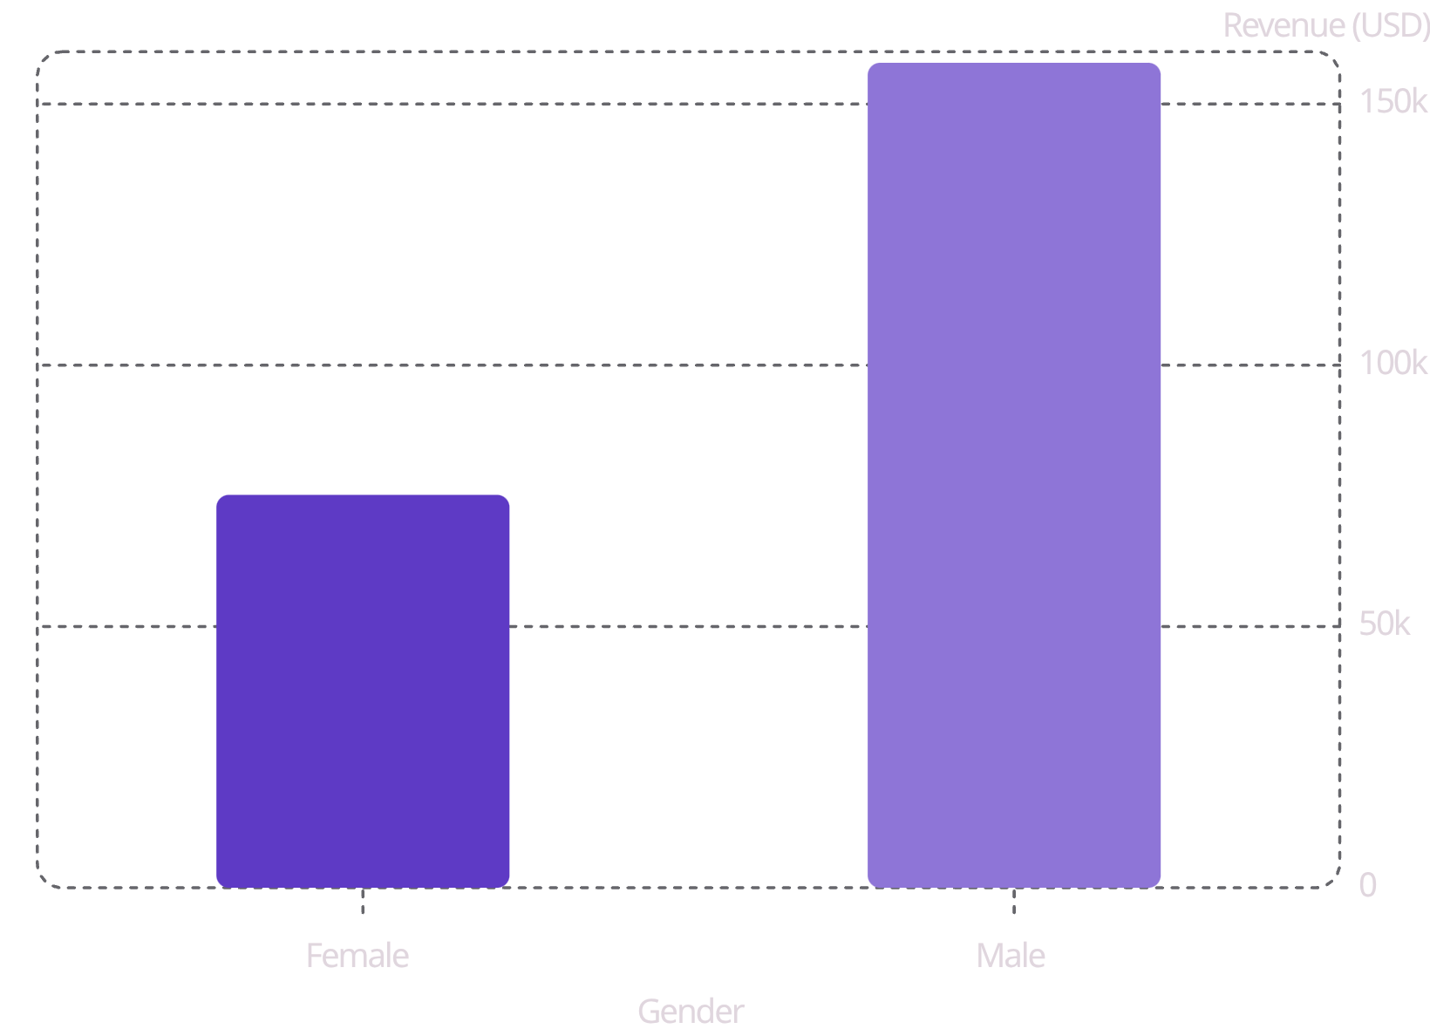
Revenue & Spending Insights
Key Findings
Male customers generated 2.1x more revenue than females
839 customers used discounts yet spent above average
Express shipping averaged $60.48 vs. Standard $58.46

Slide 5
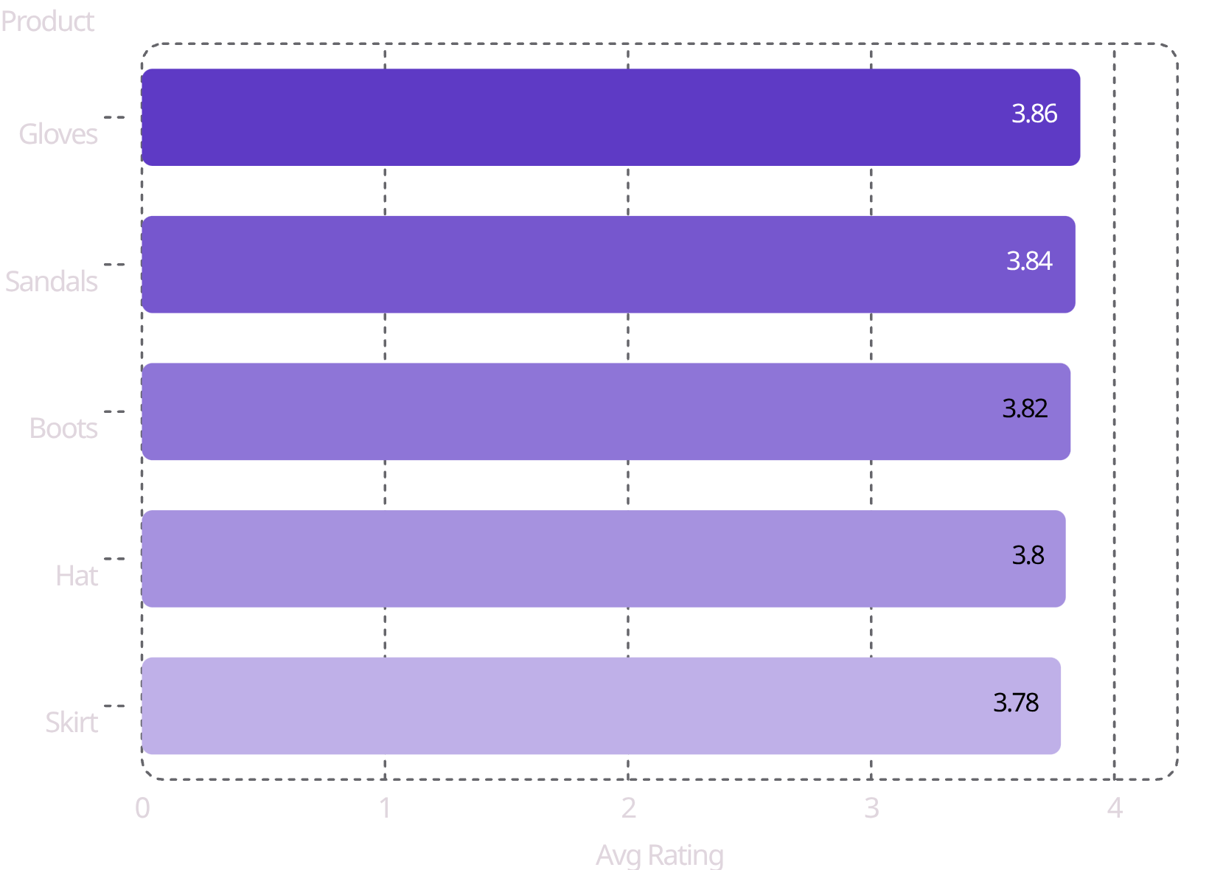
Top Products by Rating
Discount-Dependent Products
Products with the highest share of discounted purchases:
Hat — 50% discounted
Sneakers — 49.66%
Coat — 49.07%
Sweater — 48.17%
Pants — 47.37%

Slide 6
Subscription Behavior
27%
73%
Subscribers
Non-Subscribers
1,053 customers · Avg spend $59.49
2,847 customers · Avg spend $59.87
$62.6K
$170K
Subscriber Revenue
Non-Subscriber Revenue
Total revenue from subscribers
Total revenue from non-subscribers
Of customers with 5+ purchases, 958 subscribed vs. 2,518 who did not — repeat buyers are more likely to subscribe.

Slide 7
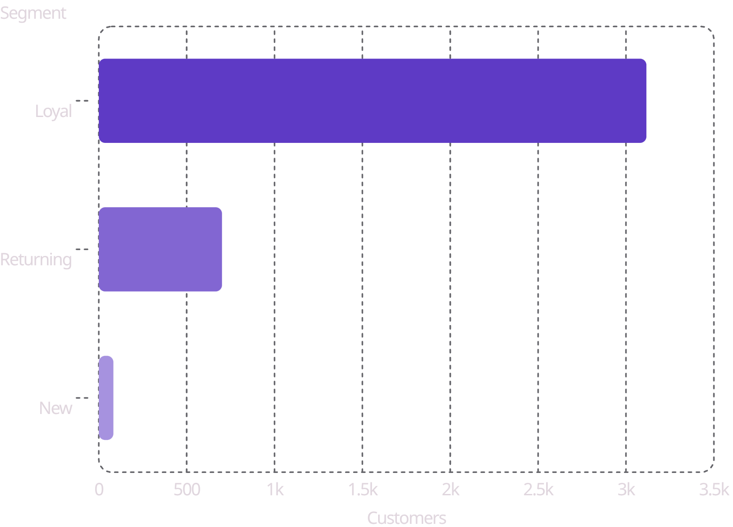

Customer Segmentation
Segment Definitions
Loyal — 3,116 customers (80%)
Returning — 701 customers (18%)
New — 83 customers (2%)
Loyal customers dominate — focus on retention and upsell programs.

Slide 8
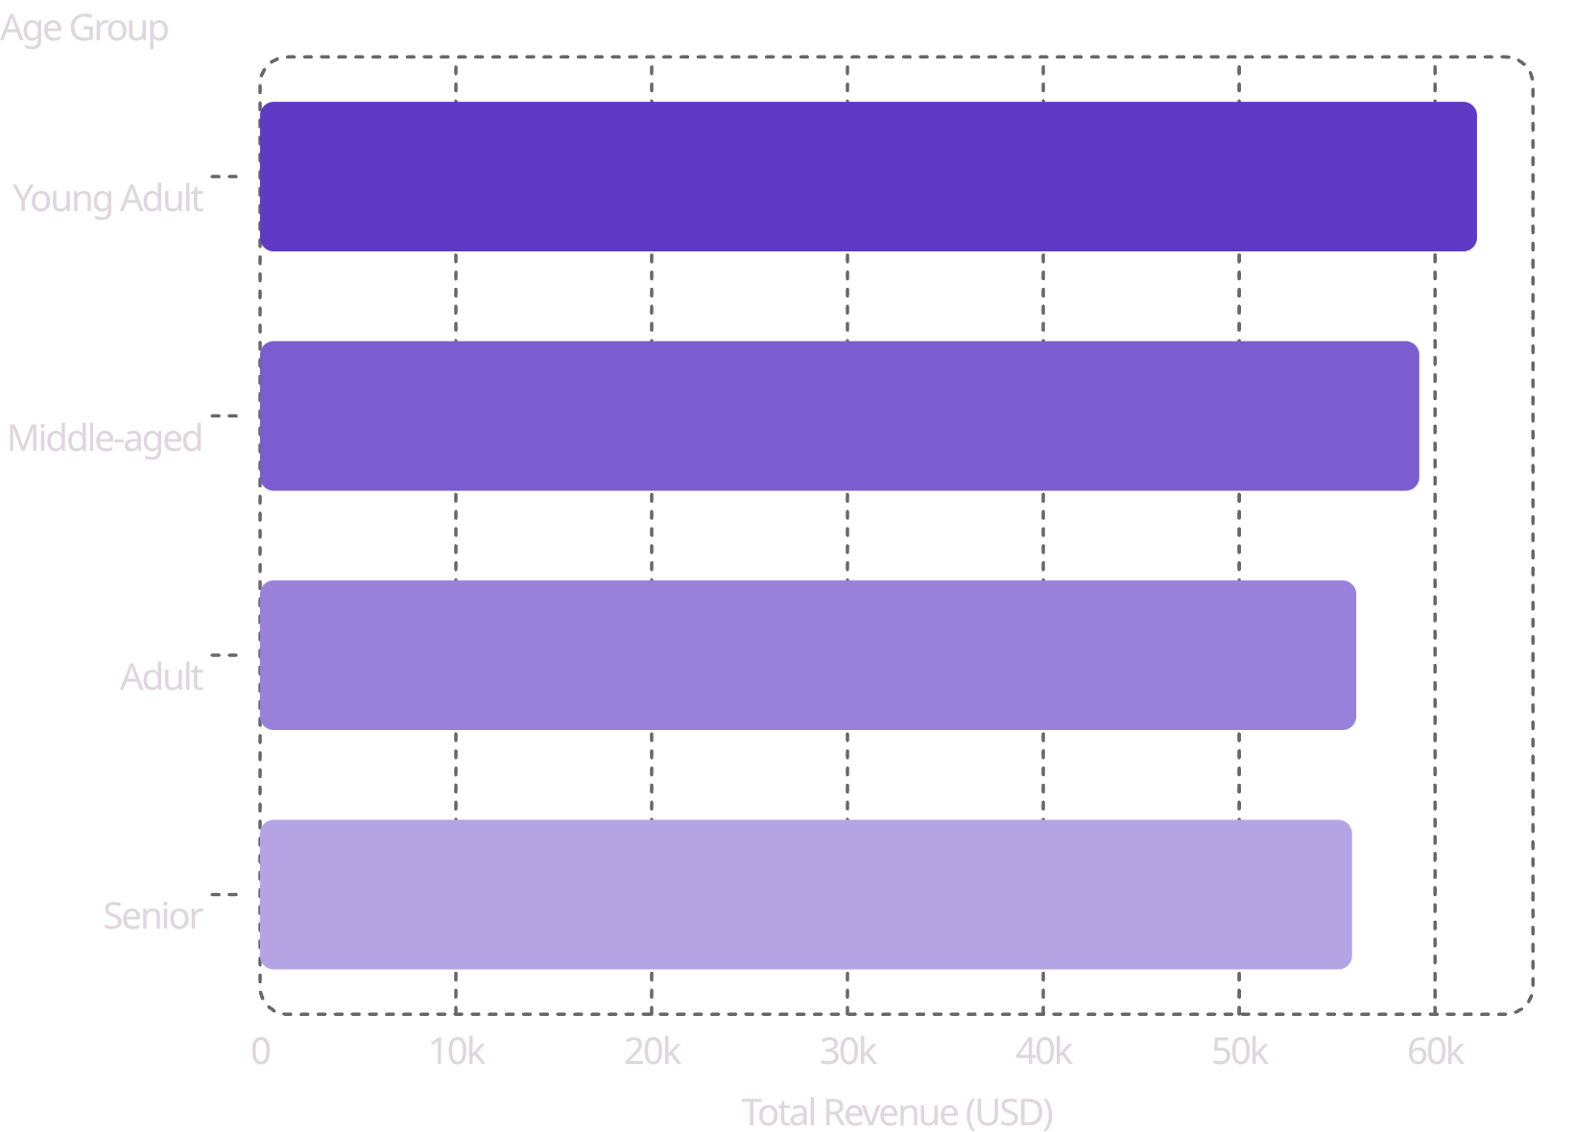
Revenue by Age Group
Age Group Insights
Young Adults lead in total revenue
Revenue is relatively evenly distributed across all groups
Targeted marketing should focus on high-revenue age segments

Slide 9
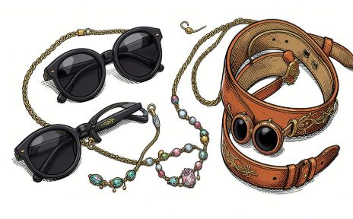
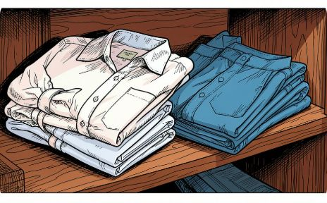
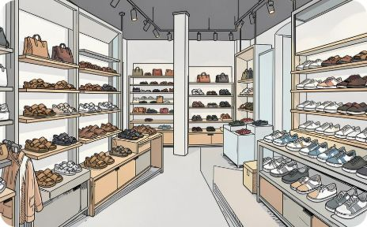
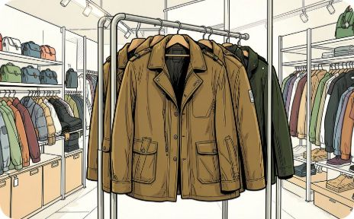
Top Products by Category
Accessories
Clothing
Footwear
Outerwear
Jewelry · Sunglasses · Belt
Blouse · Pants · Shirt
Sandals · Shoes · Sneakers
Jacket · Coat

